Slide 1
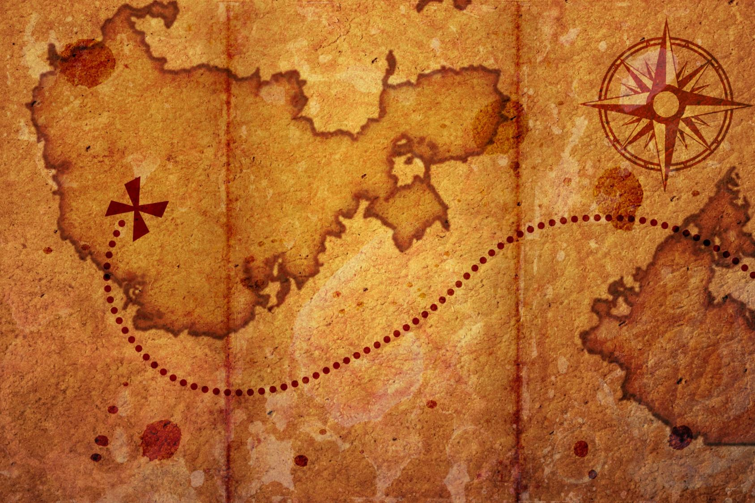
a Quest
Going on

Slide 2


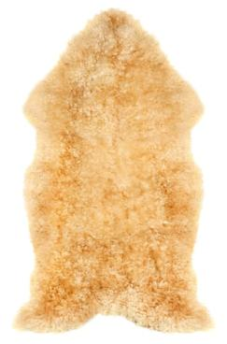
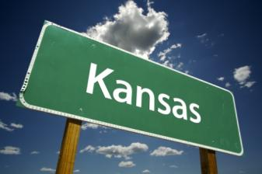
All the things below have been the object of a famous quest in literature (and film!). Whether to find or destroy, help or hinder, can you name the hero who led each tale?
The one ring . . .
The white whale . . .
The golden fleece . . .
Home sweet home . . .
What other books or films contain your favourite quests?

Slide 3
What makes a quest a quest?
A quest is a journey towards a goal. These goals can vary – from objects to ideas. What examples can you think of?
Quest stories usually have a central hero (with skills and flaws like the rest of us).
And the heroes face obstacles to overcome along the way, learning and changing as they go.

Slide 4
Send your own hero on a quest
Knowing these basic elements of a quest, write your own quest short story.
Plan out the course of events:
  Introduce a goal that must be reached/solved/fixed/etc.
  Think about your hero and why he or she feels the need to venture out in pursuit of this goal.
  Trip-up your hero a few times along the way, but don’t forget about the consequences or results of those challenges!

