Slide 1

HOW A
BOOK
IS MADE

Slide 2

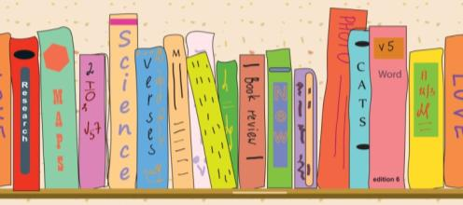
?
Who?
What?
Where?
Notes:
What you may not know is that it takes lots and lots of work to make a book. This presentation tells you <click>
Who works on the books. <click>
What it takes to put books together. <click>
Where the books go when they’ve been made and how they’re sold.
<next slide>

Slide 3

Who:
The editor
Notes:
The first ‘who’ in book-making is the editor. The editor looks after each step of the book-making process. Editors make many books during the year and work with lots of other people who help get the books ready.
The skills editors need include:
Project management – making sure content is written in time
Editorial skills used when reviewing manuscripts
Maths skills for example working out whether a book or product is going to be profitable
Analytical skills – for ensuring how ideas match what people need and the needs are gathered by research
Communication skills – for presenting ideas and listening to feedback
<next slide>

Slide 4

Who:
The
author
Notes:
The author, of course, writes the book. Some books actually have more than one author, with each author writing different chapters of the book.
The author needs to be able to write original content to a defined brief and deliver the material to tight deadlines. They should also be able to take on feedback.

Slide 5

Who:
The designer
Notes:
The designer is given all the words and pictures, and they use a design programme like Quark or InDesign to put the book pages together.
Skills needed for a designer are:
Appreciation of what makes good design
Time-management skills
Attention to detail

Slide 6
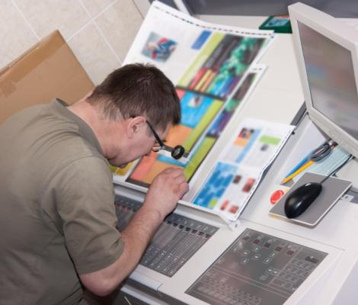
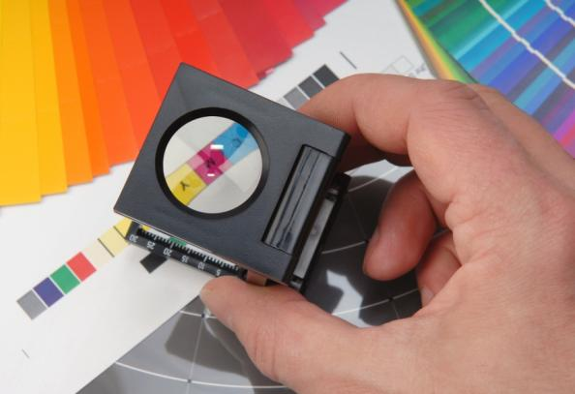
Who:
The production team and the printer
Notes:
Most people also forget that someone has to turn all those computer files into a printed book or an eBook – otherwise you wouldn’t be able to read them! The production team and the printer work together to bring you the lovely books that fill your shelves (or your iPad). The production team will negotiate dates and rates with the printers and shippers, choose and order the right type of paper, and do a technical check of the files before they go to press.
The skills needed to work in production or printing are:
Project management
Communication skills – especially if there are delays and you’re working with companies based overseas!
Mathematical skills
Technical skills

Slide 7


Who:
The marketing and sales teams
Buy
Books!
Notes:
The editor will also work with the marketing and sales teams from the initial idea until the book is ready to be sold. The marketing department will make sure information about the book is released to our website, to Amazon and to other booksellers, before publication. They will help to shape the big idea of a series or book to make sure it appeals to its target audience. They will plan a programme to promote the series through leaflets, catalogues, flyers and our online channels, and produce exciting copy for each of these promotions.
The sales team will present the books and products to booksellers and, in the case of education, face-to-face to teachers.
The skills needed to work in sales and/or marketing are:
Persuasive communicators – face-to-face and through written copy
Analytical/research skills
Mathematical skills
Charisma!

Slide 8

What:
The idea
Notes:
To make your own book or series, like we do every day, first you need to come up with an idea. This is what the book is going to be about.
What kinds of things do you like to read about? <take ideas> How about we make a short horror story. So now we have an idea of the topic for the book and the kind of book it’s going to be.
<next slide>

Slide 9
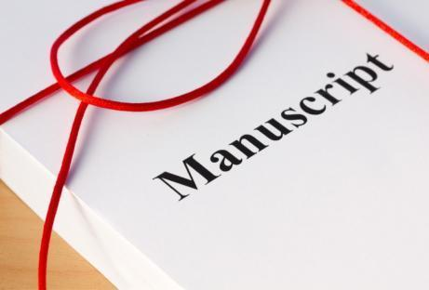
What:
The development
An excerpt from the Lone Wolf manuscript:
He saw it in flashes, a shadow of prickly fur, the gleam of teeth, yellow eyes glowing in the darkness. Danny froze. He thought wolves had died out hundreds of years ago, but there was no questioning the creature in front of him. The wolf prowled silently towards him. The huge muscles of its back and shoulders shifted beneath its fur. Danny remembered reading that wolf attacks on humans were rare, but something in those glowing eyes told him he was about to become an exception.
Result: The final manuscript
Notes:
This is when all the ‘whos’ of the team work very hard to make the initial idea grow into a successful product.
The next step is to start planning and writing the book. We talk to the author about the idea and then the author goes away and writes a first draft. We give feedback on the draft and make suggestions for how it could be improved. It’s edited by a copyeditor to remove any errors. In the end <click>, the author has written all the words and we are ready for the next step.
<next slide>

Slide 10

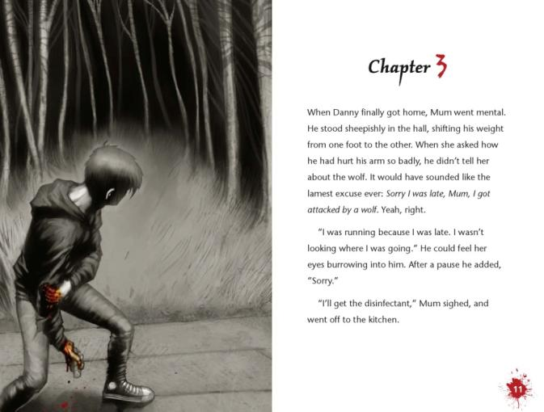
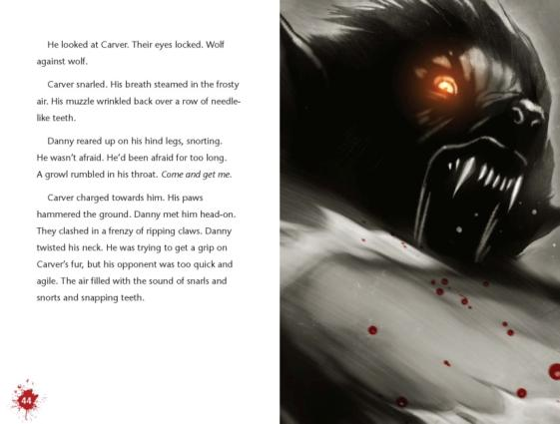
What:
The layout and design
Notes:
When both the words and pictures are ready, the designer can begin putting them together to make the pages! Of course we can’t forget <click> the cover of the book. The designer works hard to make the cover look exciting and fun.
We then go back to check for any mistakes and prepare the book for the printer.
<next slide>

Slide 11
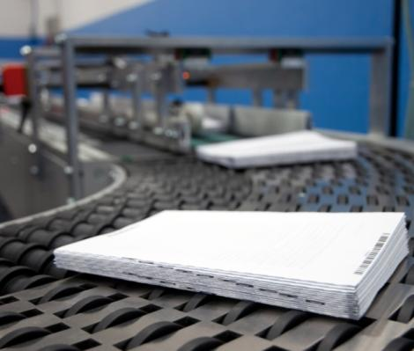
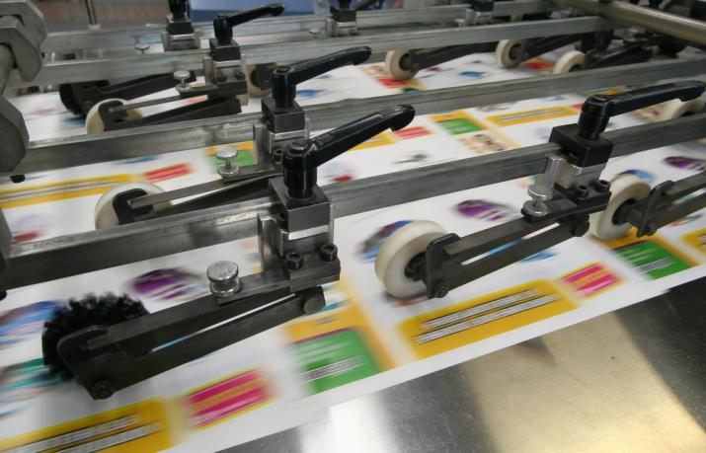
What:
The printing and binding
Notes:
When it all looks good, the pages and the cover are sent to the printer. The printer prints thousands of copies of the book!
Who here reads books online or on a tablet, phone or e-reader? <take answers/show of hands>
If you’re making an e-book as well, then the files would be converted from InDesign files to e-Pub files, ready to be downloaded to your Kindle, iPad, smartphone or tablet.
<next slide>

Slide 12
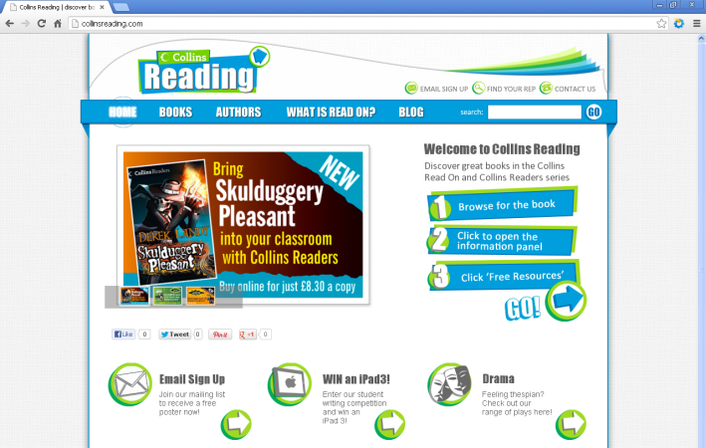
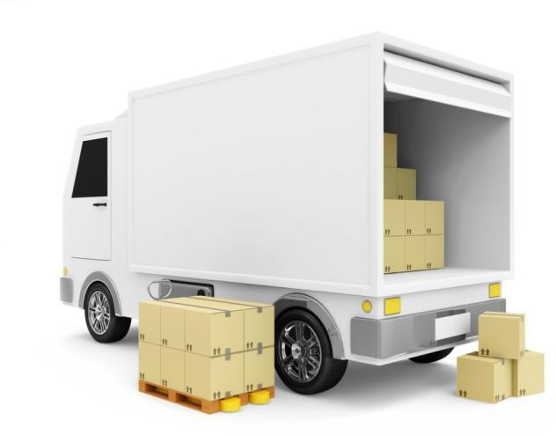
What:
Getting it out there
Don’t forget: buy books!
Sales
Marketing
Distribution
Notes:
The books are shipped from the printers in China to the warehouse and finally released.
The marketing campaign has already begun and the sales rep force are ready to start selling.

Slide 13
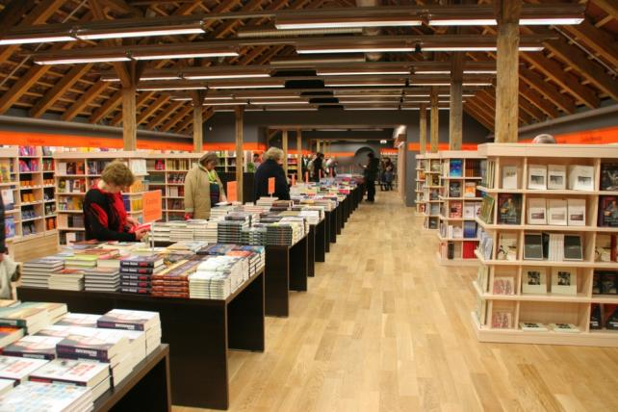



Where:
Bookshops
Schools & libraries
Online
Notes:
So where do these thousands of books go? They get sent out to all sorts of places. The books go to <click> bookshops, <click> schools and libraries, <click> and we even put them online so you can buy them from your favourite website.
So, Read On!

