Slide 1
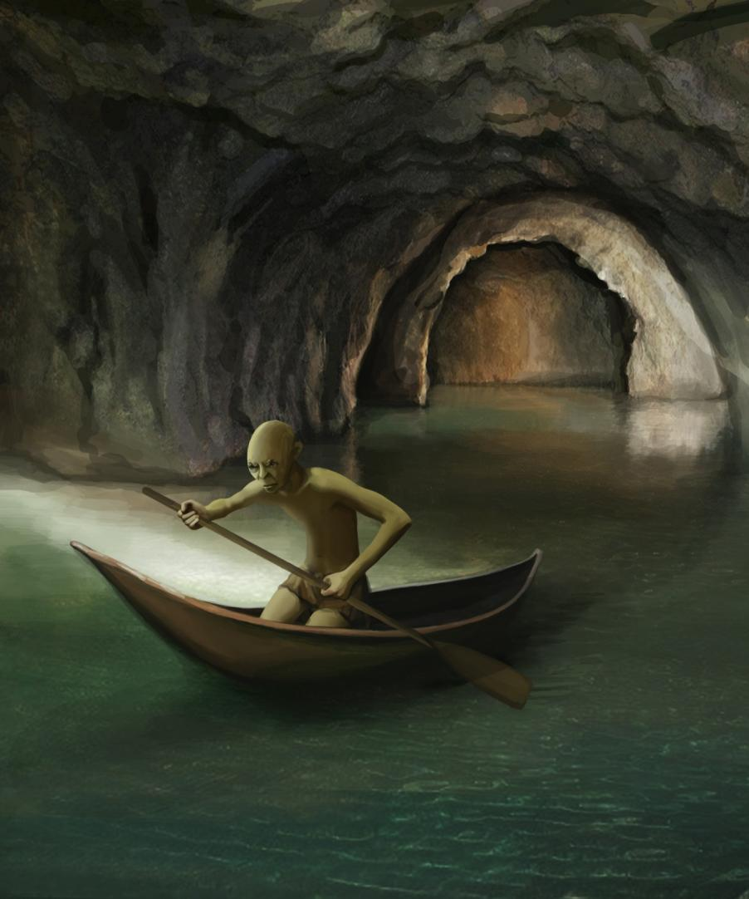
Who was Gollum?

Slide 2
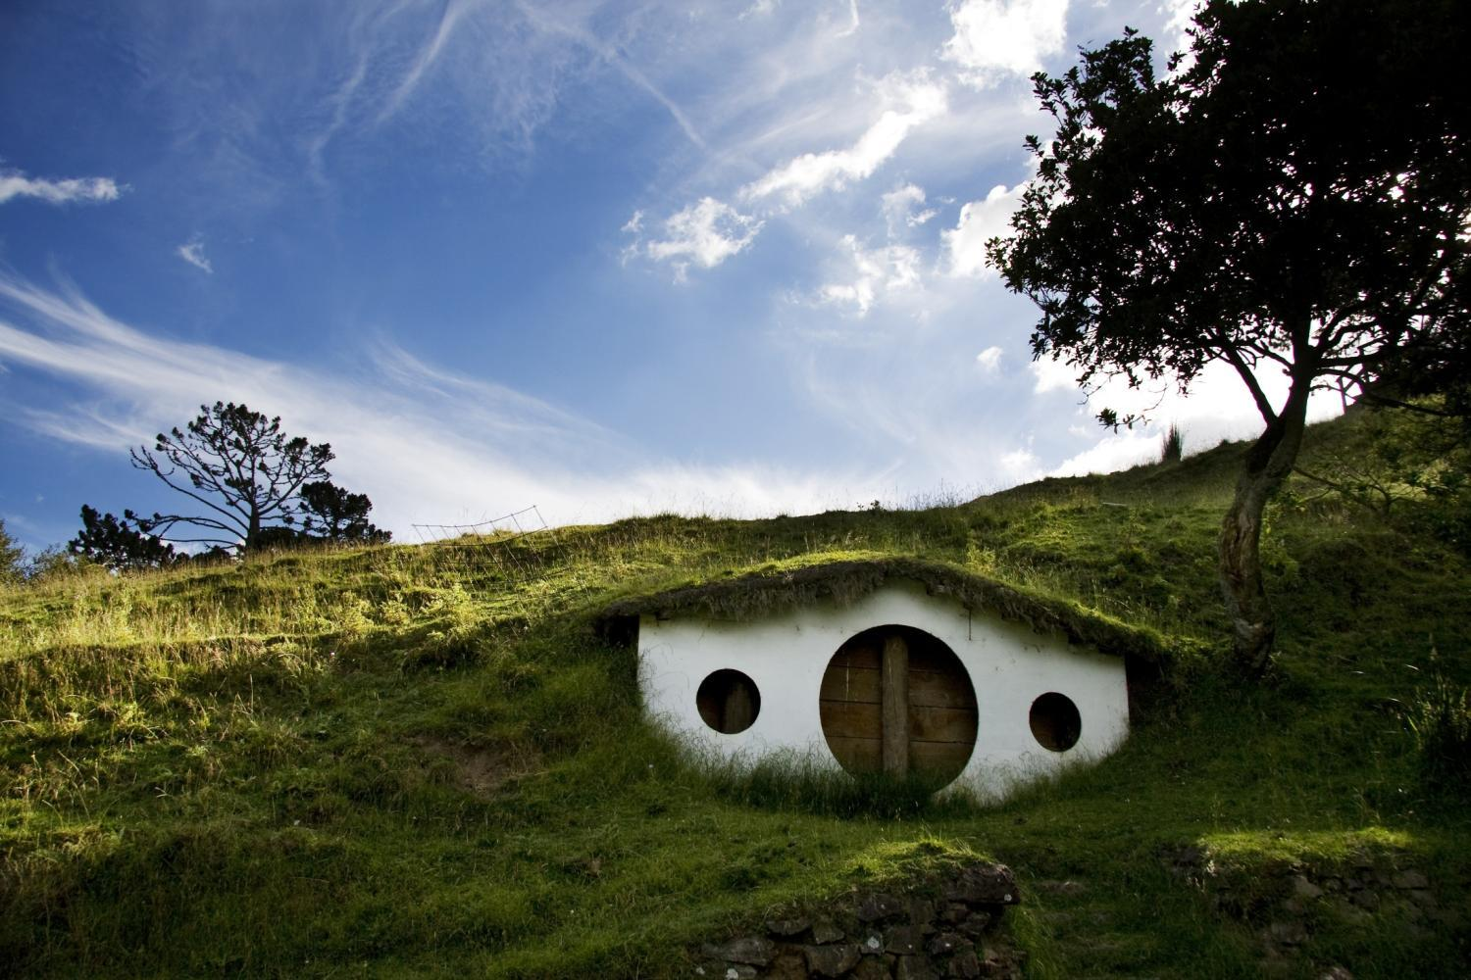
Gollum came from somewhere, but what led to his fall?
YOUR TASK:
Write a prequel about Gollum as a young hobbit named Smeagol, living in a place very similar to Bilbo himself. What was Smeagol’s life like before the ring 'possessed' him and what steps led to his demise?
You may know some of the details Tolkien provided about Smeagol in his other books, so feel free to incorporate those – or just rewrite his history as you see it.

Slide 3
SOME THINGS TO THINK ABOUT AS YOU PLAN AND WRITE
The early days:
Did Smeagol ever come across Bilbo's relations, the Tooks, in his life as a hobbit?
Did he have any brothers and sisters and what were they like? What about his parents?
Did he have a job? What might he have done?
Was he a happy-go-lucky character or did he always show hints of a Gollum-like personality? What made him particularly vulnerable to the draw of the ring?
He finds the ring:
How? This makes him moody ... a personality change. He becomes possessive. He falls out with other Hobbits. What other consequences can you imagine? For example:
  Argues with his boss – gets the sack.
  Big argument with his brother – goes to live on his own, preferring the dark.
  His features change; he becomes uglier as his nature turns ugly.
  When invisible, he sneaks back to the shire to have revenge on his boss and his brother. How? What does he do?
Activity concept by Collins Read On author, Keith West

