Slide 1
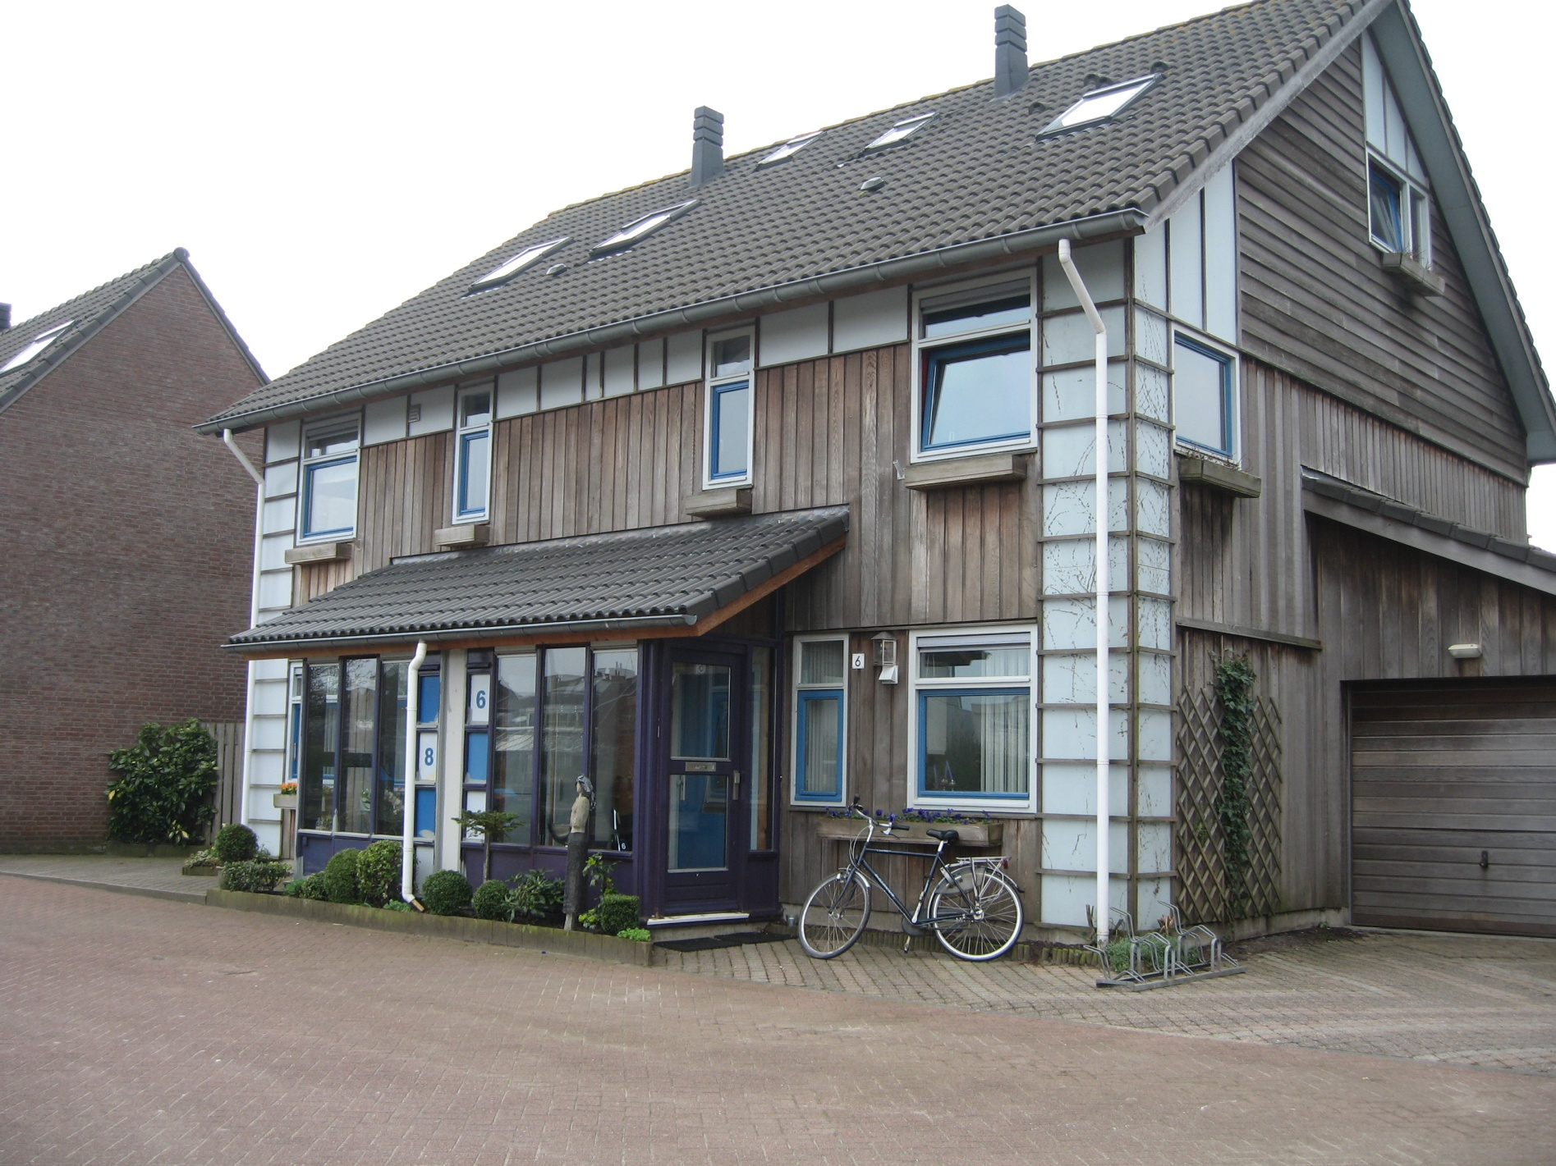
Big Cat How to Build a House Activity Sheet Down my Street
1
©HarperCollinsPublishers 2016

Slide 2
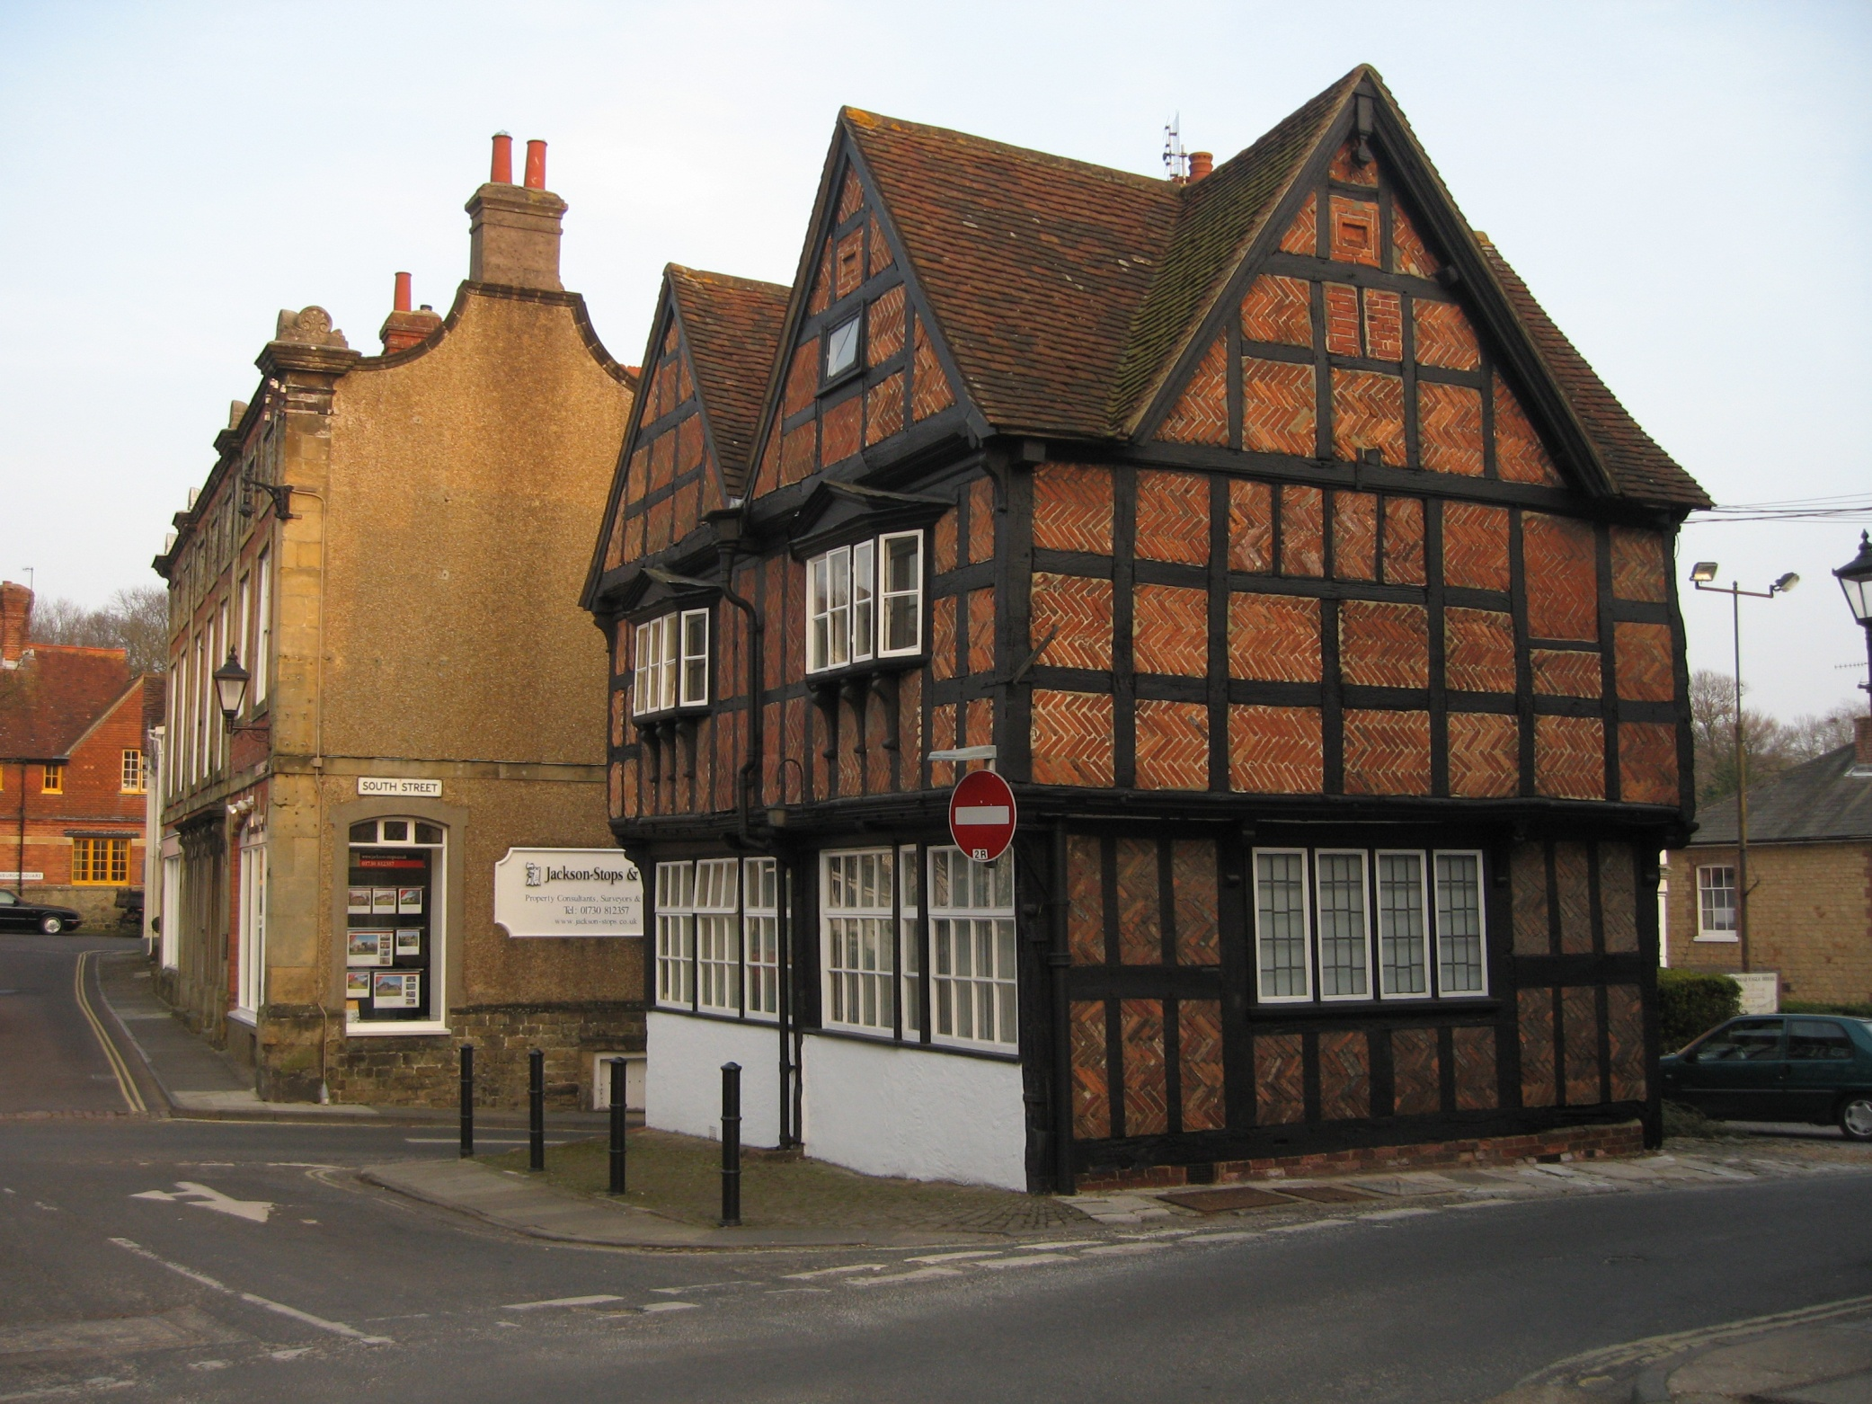
2
©HarperCollinsPublishers 2016

Slide 3
3
©HarperCollinsPublishers 2016

Slide 4
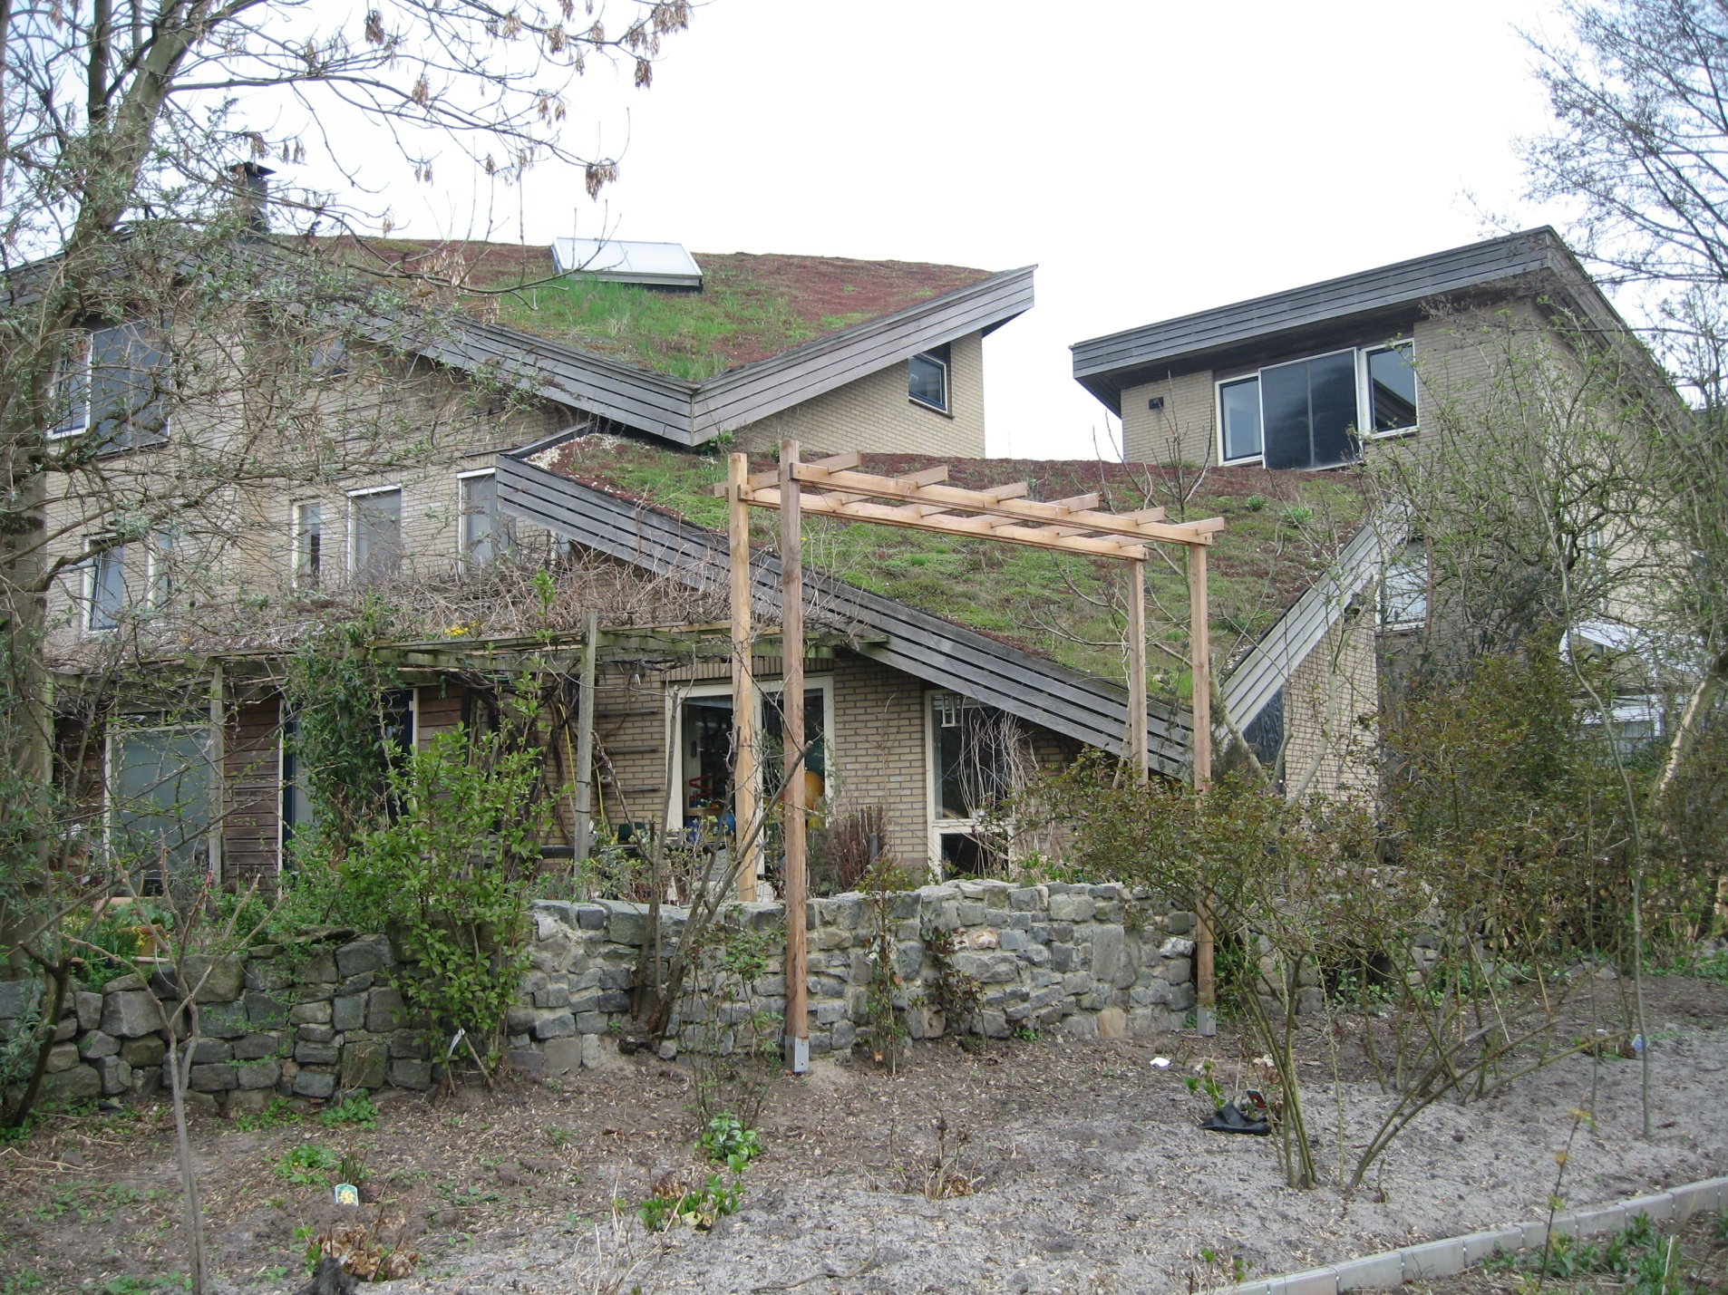
4
©HarperCollinsPublishers 2016

Slide 5
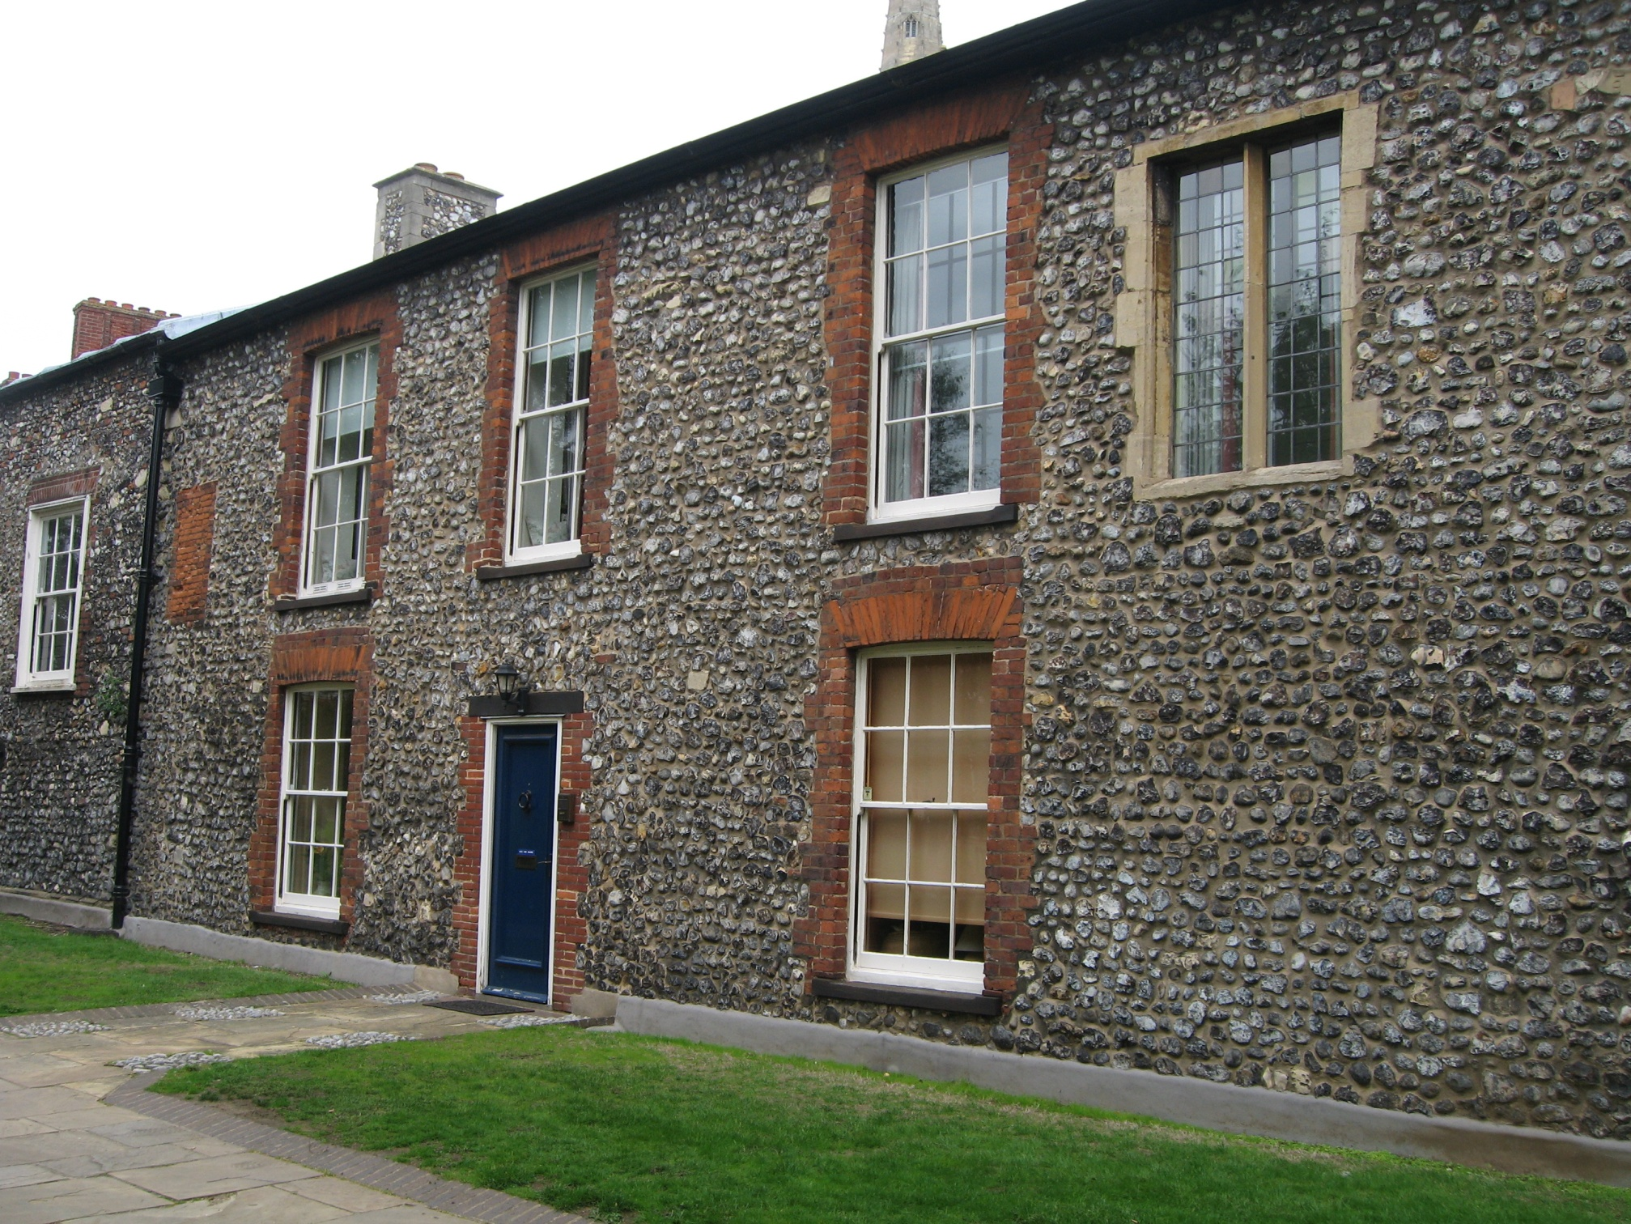
5
©HarperCollinsPublishers 2016

Slide 6
6
©HarperCollinsPublishers 2016

Slide 7
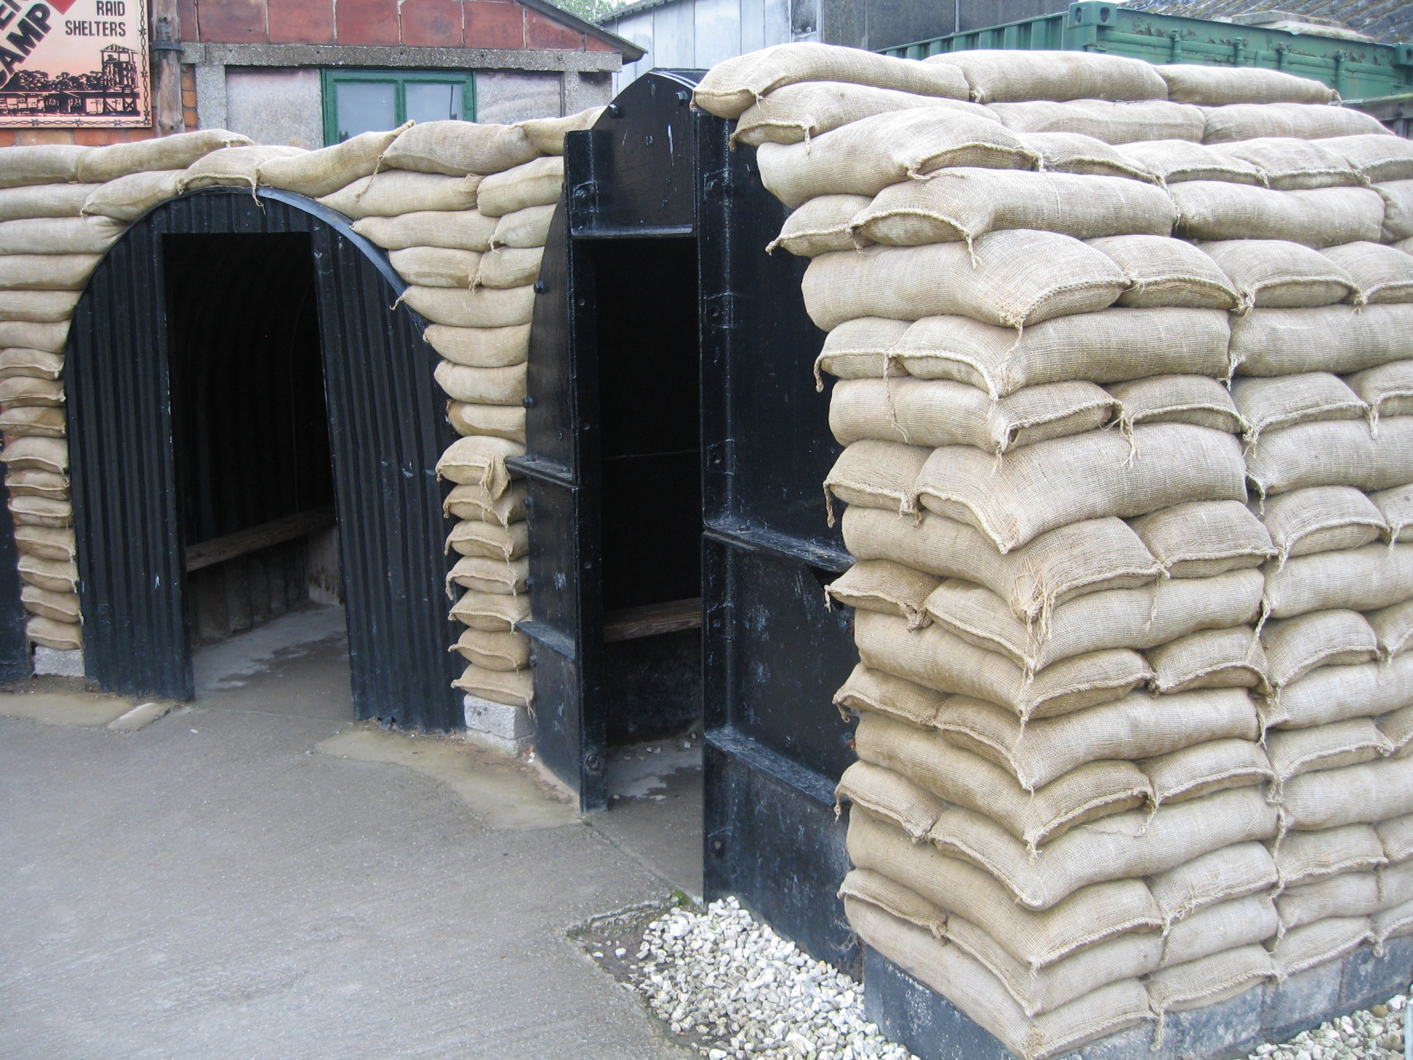
7
©HarperCollinsPublishers 2016

Slide 8
8
©HarperCollinsPublishers 2016

Slide 9
9
©HarperCollinsPublishers 2016

Slide 10
10
©HarperCollinsPublishers 2016

