Slide 1
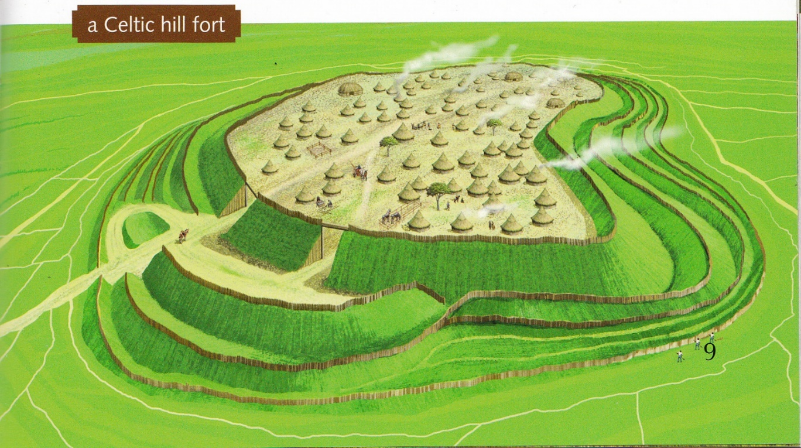
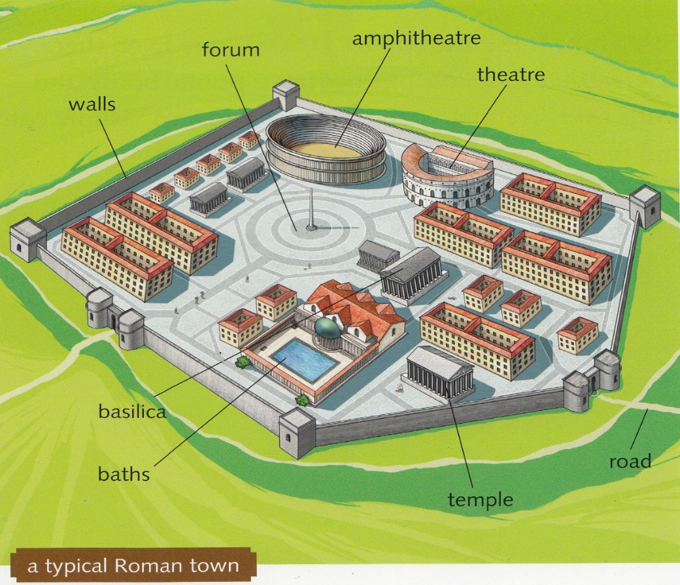
Big Cat Boudica Information Sheet
Comparing A Hill Fort with a Roman Town
©HarperCollinsPublishers 2016

Slide 2
Big Cat Boudica Activity Sheet
Comparing A Hill Fort with a Roman Town
What is the fort made out of and why are there so many ditches?
What materials are the buildings made out of?
What sort of activities would you see in the hill fort and villages?
Draw in the part of the picture that is missing
What materials are the walls made out of, what has been placed at each entrance and how many are there?
What materials are the buildings made out of?
Name some of the buildings in the town and describe what they are used for.
Draw in the part of the picture that is missing
©HarperCollinsPublishers 2016

